Slide 1
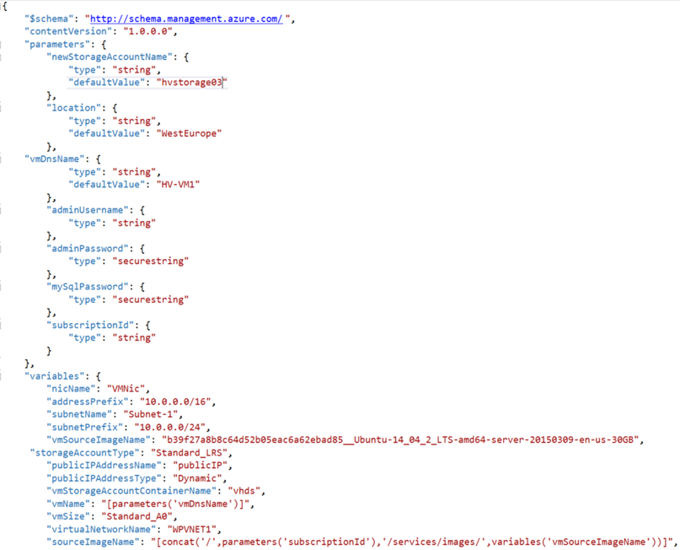

WTH Event-driven FHIR Patient Search
Azure Serverless
Functions, Event Hubs, Cosmos DB, FHIR and more…
[your hack dates]
Richard Liang
Peter Laudati
Gino Filicetti
Cloud Solution Architects

Slide 2
Kick Off Agenda
Welcome & Intros
How all of this will work
Kick off & squad formation
Technology overview
Hands on Challenges & team learning!
Notes:
Welcome to homeroom… where we take attendance and make all the announcements, say the pledge of allegiance, etc.

Slide 3
WTH Event-driven FHIR Patient Search
Hackathon
Welcome & Intros
Gino Filicetti
Peter Laudati
SME – Azure IaaS
SME – Azure IaaS
Richard Liang
[Your Name]
SME – Azure IaaS, FHIR
SME – [your skill set]
Notes:
Bem vinda! Bienvenidos!
Welcome to the OCP P20 Level UP! event
Olá! Meu nome é Peter Laudati
Eu sou djee Nova Jersey
Y por mis amigos de los otros paises,
Me llamo Peter. Soy de Neuva Jersey, y yo vivo circa de Neuva York.

Slide 4
Objectives
What to Expect:
Overview of FHIR Server Sample Architecture, including Azure API for FHIR
Deep dive into Azure Functions, Event Hubs, Cosmos DB, Search
Hands on work, lab exercises to:
Create FHIR Server sample environment to provision FHIR Server (PaaS scenario) and FHIR Bulk Load components (Bulk Load function app, fhirimport Blob Storage).
Create Event-driven environment to provision Event Hubs for data ingestion, Stream Analytics for data processing and Cosmos DB to persist processing results.
Create function apps to load mock patient data (or use Synthea Patient Generator tool) and push to FHIR Server, to retrieve patient data from FHIR Server and push to Event Hubs.
Create Azure Cognitive Search to index patient data stored in Cosmos DB
Create Patient Search web app and deploy to Azure App Services
Intended Outcomes:
WTH participants will walk away with:
Ability to write serverless function apps with integration bindings
Ability to deploy and interact with FHIR Server
Templates created for FHIR Server sample architecture
A deeper understanding of Serverless and Event-driven architecture

Slide 5
Agenda Monday & Tuesday
PowerPoint Overview
Iterative hands on challenges
Breaks for food and stretching
More team challenges
Sharing & recaps throughout the day

Slide 6
Challenge #0 Pre-requisites – Ready, Set, GO!
Install Windows Subsystem for Linux (Bash Shell)
Install the Azure CLI (V2)
Install PowerShell Cmdlets for Azure
Install Visual Studio Code (and extensions)
Install the latest version of Node.js (at least 10.x) and npm
Notes:
If you have a Mac… great! You’re already a step ahead.
If not, get your Windows box loaded up with all the tools that work well in the OSS world!

Slide 7
Challenge #1 Extract, transform and load patient data
Deploy Azure API for FHIR for data ingestion of FHIR patient data
Mock/Simulate patient data and load them into FHIR Server
Notes:
If you have a Mac… great! You’re already a step ahead.
If not, get your Windows box loaded up with all the tools that work well in the OSS world!

Slide 8
Enabling Healthcare Solutions in Azure

Slide 9






Modern Healthcare Solutions Face New Challenges
TRADITIONAL HEALTH DATA SYSTEMS
Interoperability
Security
Compliance
EVOLVING DATA SYSTEMS
Notes:
Organizations building healthcare solutions face significant challenges as the data needed for modern solutions leveraging advanced analytics and machine learning can be difficult to access and is often segregated into different silos based on a variety of healthcare systems including electronic health records (EHR), financial/billing systems, customer relationship management (CRM) for marketing, picture archiving and communication systems (PACS) for imagery and more. To further complicate matters, evolving health data systems, including connected devices in the Internet of Medical Things (IoMT), genomics and immunomics systems, big data sets from government agencies and research institutions and more, make it difficult to get a complete view of a patient’s or population’s data. The desire is to bring all this data together to build modern healthcare solutions that can improve clinical, financial, operational, and population health analytics. The ability to digitally capture, annotate, and combine data to apply machine learning will transform the delivery of healthcare.
In order to successfully bring together the relevant data and apply machine learning, organizations require a platform that supports standards-based interoperability, the security and privacy needed when working with PHI, and the compute capability to process a large amount of data.

Slide 10



Unblock healthcare innovation with health data interoperability
Based on industry standards for health data interoperability
Secure management of Protected Health Information (PHI) in a compliant cloud environment
Accelerate machine learning, data analytics, and operational outcomes with data in a normalized state
Azure API for FHIR

Slide 11

Enabling Interoperability of Health Data
INTEROPERABILITY
RESEARCH
STARTUP
Create new healthcare systems of engagement by connecting data from multiple systems of record.
Enable new research opportunities through normalized clinical data.
Focus on the innovations you are investing in instead of the data platform.
Notes:
According to the paper published in JMIR Medical Informatics “despite the relatively rapid nationwide adoption of electronic health records (EHRs), the industry’s ability to successfully exchange computable health data has not kept pace. A recent study found that less than 35% of providers report data exchange with other providers within the same organization or affiliated hospitals. The exchange of data across organizations is even more limited, with less than 14% of providers reporting they exchange data with providers in other organizations or unaffiliated hospitals.” These systems have been developed using older standards, including HL7® v2.x, Clinical Document Architecture (CDA) and proprietary APIs that make it challenging for healthcare solution developers to leverage these systems across healthcare providers. This has significantly limited access to healthcare data across providers and made it far too difficult to gain insight that can be derived from analytics and machine learning.
Azure API for FHIR® implements the HL7® FHIR® specification, enabling interoperability based on an emerging industry standard data model and RESTful interface for health data. The cloud-based API supports SMART on FHIR® integration with Azure Active Directory to enable 3rd party application developers to leverage existing application development.
The Azure API for FHIR® was designed around three primary use cases – health system interoperability, research, and startup/innovation health projects. Across these use cases is a similar pattern – data from one or more systems of record coming together in a single persistence model through the Azure API for FHIR® and being enriched through analytics and machine learning. New systems of engagement interact with the data through the Azure API for FHIR®.
Health System Interoperability
While EHRs exist as the primary ‘source of truth’ in many clinical settings, it is not uncommon for providers to have multiple instances of the same EHR offerings (10 variations of Epic installations), different EHRs in different parts of their ecosystem (5 Cerner EHR installations and 2 Epic installations) or to have several non-EHR databases that serve as a source of truth (e.g. PACs systems, research databases, IOMT databases, etc.). A typical provider ecosystem can house 20 (or more) databases that often don’t talk to one another or store data in different formats.
Standardizing on FHIR provides a more open and stable data structure and use of the Azure API for FHIR as a service that sits on top of those systems helps to enable interoperability and data exchange.
As institutions begin to implement various ML application to datasets, the Azure API for FHIR provides easy data exchange and means to annotate patient data thru FHIR APIs.
Research
Healthcare researchers will find the FHIR standard in general and the Azure API for FHIR useful as it normalizes data around a common FHIR data model and reduces the workload for machine learning and data sharing.
Exchange of data via the Azure API for FHIR provides audit logs and access controls which help control the flow of data and who has access to what data types.
Startup & Innovation Projects
Customers developing a patient or provider centric app (mobile or web) can leverage Azure API for FHIR as a fully managed backend service. The Azure API for FHIR provides a valuable resource in that customers can managing data and exchanging data in a secure cloud environment designed for health data, leverage SMART on FHIR implementation guidelines, and enable their technology to be utilized by all provider systems (e.g. most EHRs have enabled FHIR read APIs).

Slide 12
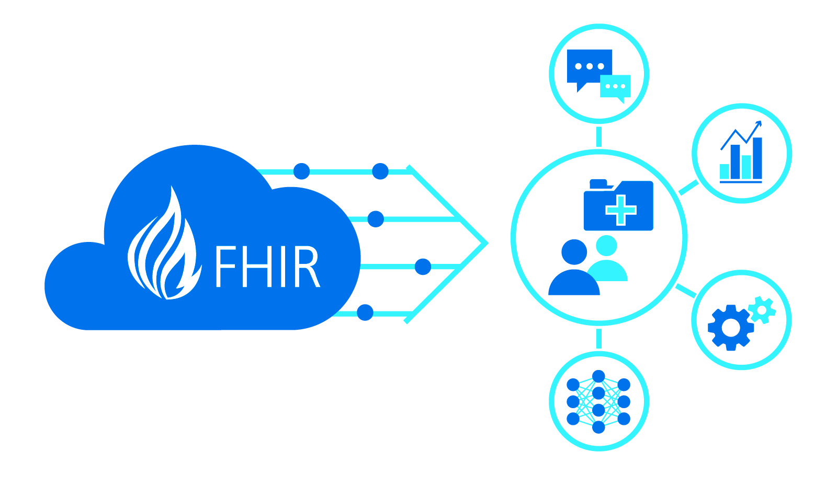
Connecting at the point of care
Health system interoperability
New systems of engagement – clinician apps, patient apps
Research and startup projects (e.g. IoMT)

Slide 13












Enabling Healthcare Solutions in Azure
EHR
Imaging
-omics
Ingest & Enrich
Easily ingest and enrich any volume, variety or velocity of Healthcare data.
Persist
Create unified longitudinal records and track lineage.
Query & Provision
Provision and manage access for querying, exploration, operationalization.
Intelligence
Create new insights and build targeted AI models on the entire data estate.
3rd Party Data
IoMT
Scale
Easily leverage cloud for storage or processing of a variety of modalities at scale and lower costs.
Billing / Finance
CRM
Trust
Secure, compliant and operational.
Notes:
Who do these orgs need and want?
Initiatives: Interoperability, research, innovation
Moved to new standards defined by FHIR
Enable new tech to speak to your language 5000 feet view of what orgs are looking for
All system are generating data about patient and activities of particular org
Diff to connect and operate with one another
Put everything in one place for single view
Intelligences
Ingest systems into a single place (not replace legacy system)
Perform advanced analytics on data (AI/ML)
Scalability
Azure API for FHIR:
What we built to support what customer want
Support what customer want to do thru the above workflow:
Ingest & Enrichment of data:
- ADF – pull data out of HLC systems
- IoMT – capture real-time remote data from connected devices
Azure Functions – incorporate into some workflow
Push – system can talk directly to Azure API for FHIR
Send FHIR data directly into Azure FHIR APIs
Any system can integrate with FHIR API can integrate with Azure API for FHIR (no proprietary changes)
Persist data:
API for FHIR is where data is persisted
Customer sees the API endpoint and all security around it(not underlying infra)
Implementation details are hidden behind the scenes
Interact with those endpoints to scale up/down for throughput
Query & Provision data (into tools that are relevant):
Export FHIR data into Azure Databricks to reshape the data
Analytics and ML, need data in tabular structure and pull together diff parts of the data
Intelligence
Once data is provisioned, you can bring it into difference intelligence systems and connect that out
Azure Synapse Analytics
Machine Learning, etc.
Working outwards towards the edges:
IoMT FHIR Connector

Slide 14

Two offerings to meet your needs
Open source, full control
Built managed and maintained by the Microsoft Healthcare engineering team.
Designed to enable you to operate and manage compliance.
Fully managed Azure offering
Distribution of the open source project, offered as a Platform-as-a-Service in Azure.
Meets regulatory compliance requirements for Protected Healthcare Information (PHI).
FHIR Server for Azure
Azure API for FHIR

Slide 15

Cloud Models
Applications
Applications
Applications
Applications
You Manage
Data
Data
Data
FHIR Server for Azure
Data
Runtime
You Manage
Runtime
Runtime
Runtime
Middleware
Middleware
Middleware
Azure API for FHIR
Middleware
You Manage
O/S
O/S
O/S
Cloud Provider Manages
O/S
Virtualization
Virtualization
Cloud Provider Manages
Virtualization
Virtualization
Servers
Servers
Servers
Servers
Cloud Provider Manages
Storage
Storage
Storage
Storage
Networking
Networking
Networking
Networking
On premises
Infrastructure
(as a Service)
Platform
(as a Service)
Software
(as a Service)
Notes:
<ANNIMATED>
The Healthcare API for FHIR moves the burden of operation, maintenance, updates and compliance from the customer to Microsoft.
The Microsoft Healthcare APIs for fully managed Platform-as-a-Service offerings available in Azure (i.e. resources in the Azure Portal).

Slide 16

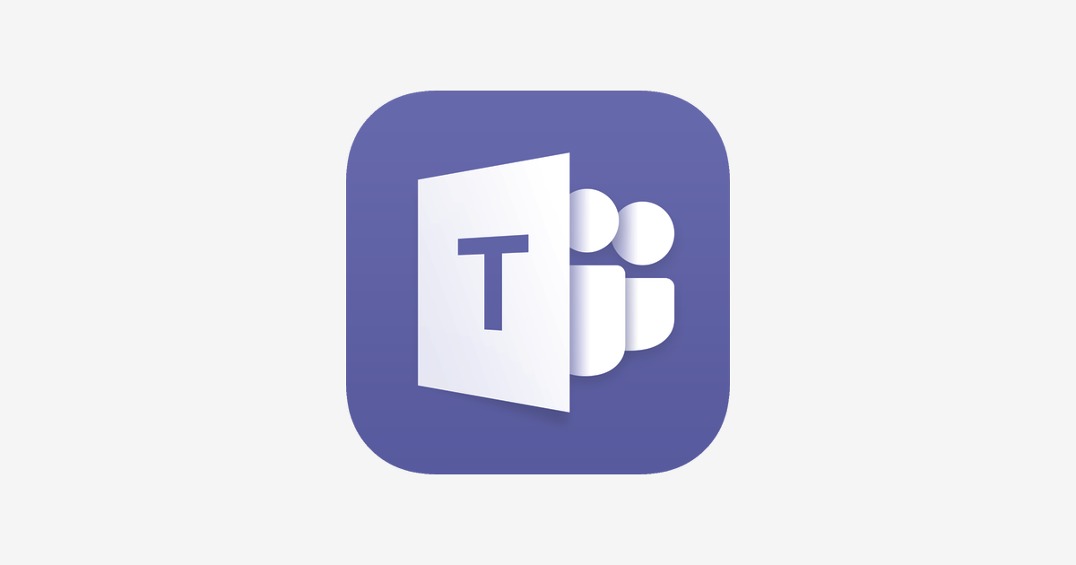








AZURE API for FHIR Example Use Case
DATA FLOW:
GENERATE
INGEST
PERSIST
ENRICH
PRESENT
FHIR
Azure API for FHIR
FHIR v3.0.1 (STU3)
FHIR v4.0.0 (R4)
Integration of multiple data sources.
Standard FHIR APIs – CRUD / Search
FHIR
Clinical Data
Patients, Procedures, Observations
Data Adaptation
Direct FHIR
HL7v2.x → FHIR
CCDA → FHIR
CSV → FHIR
Text → FHIR
Analytics & AI
FHIR
HL7v2
CCDA
CSV
Text
Insight
HDInsight
SQLDW
Azure Data Lake
-omics
Genomics, Immunomics
SYSTEMS OF RECORD
Normalize
Terminology Services (e.g. ICD-10, SNOMED CT, LOINC, RxNorm)
SYSTEMS OF ENGAGEMENT
FHIR
FHIR
Devices
IoMT, Wearables, Monitors
Intelligence
Machine Learning
Cognitive Services
Patient / Clinician Portals
Annotate
Validation (e.g. Profiles)
Labelling (e.g. Mental Health data)
3rd Party Data
Demographic, Geographic, Psychographic
FHIR
Mobile Experiences
Other Data
CRM, Billing, Marketing
Identity, Security & Audit
Identity management, audit logs, role-based access control
Dashboards

Slide 17
http://github.com/Microsoft/fhir-server-samples
FHIR Server Sample Architecture
Notes:
FhirDashboard URL: https://fhirsampdevdash.azurewebsites.net (.NET WebApp) or https://fhirsampdevjs.azurewebsites.net/ (JavaScript SPA app) User: fhirsampdev-admin@fhirserversamples.onmicrosoft.com Password: Fh1rD3m0!!

Slide 18
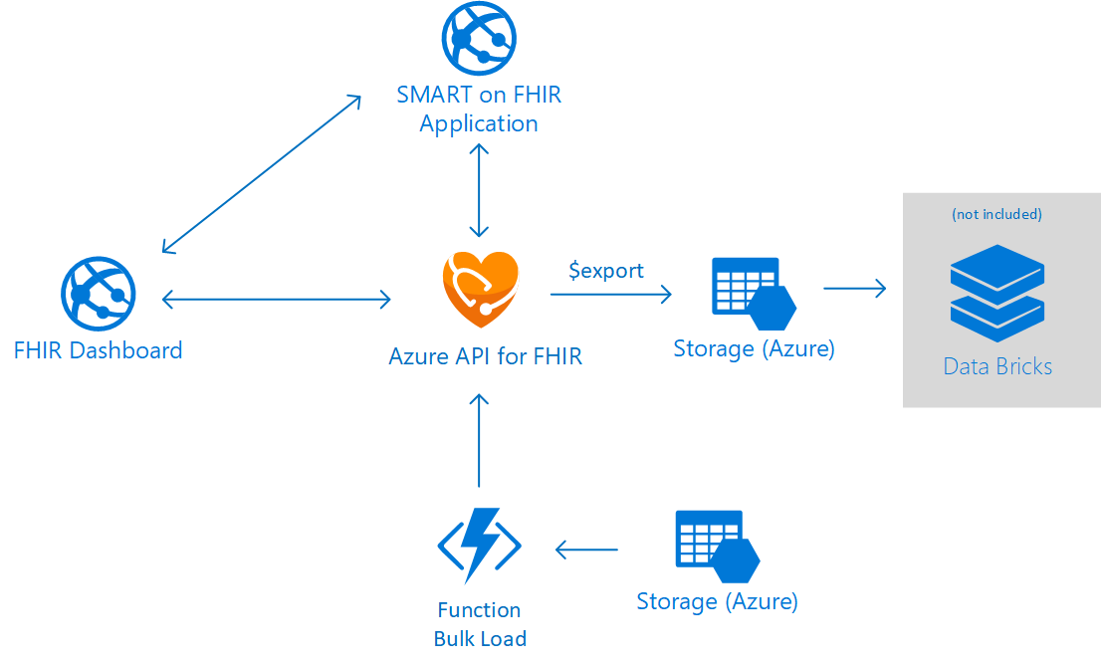


Mock
Patient Data
Simulated
Patient Data
Function
API Load
SyntheaTM
Patient Generator

Slide 19
Challenge #2 Stream patient data and unit tesing
Deploy Cosmos DB instance supporting SQL interface
Deploy serverless function app that reads from FHIR server and writes to the SQL interface of Azure Cosmos DB
Notes:
If you have a Mac… great! You’re already a step ahead.
If not, get your Windows box loaded up with all the tools that work well in the OSS world!

Slide 20
Challenge #3 Stream FHIR patient data w/ event-driven architecture
Deploy Azure Event Hubs to receive patient data event streams
Update serverless function app triggered by new patient data event sent to Event Hubs and pushes them to Cosmos DB
Alternatively, deploy Stream Analytics job to ingest data from Event Hubs and pushes them to Cosmos DB
Notes:
If you have a Mac… great! You’re already a step ahead.
If not, get your Windows box loaded up with all the tools that work well in the OSS world!

Slide 21
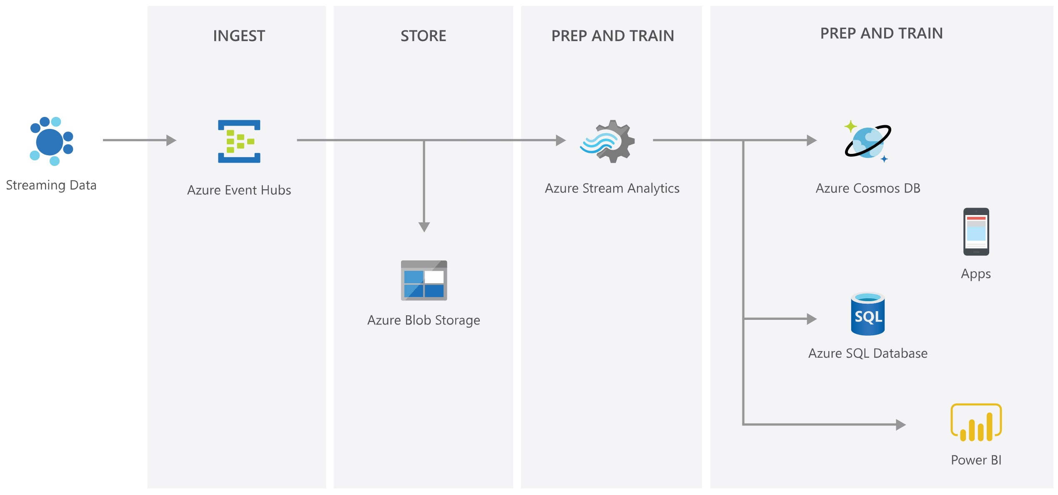


Event-driven Architecture
Azure Functions
Azure API for FHIR

Slide 22
Challenge #4 Index patient data for patient lookup
Deploy Azure Cognitive Search service to index patient data stored in Cosmos DB
Configure Cosmos DB indexer to crawl patient data and make it searchable
Add search capability through REST API operations
Build serverless REST API function app with HTTP Activation
Notes:
If you have a Mac… great! You’re already a step ahead.
If not, get your Windows box loaded up with all the tools that work well in the OSS world!

Slide 23
Challenge #5 Display patient search results
Build a web app to display patient records in pages of 10
Add a patient lookup function on Patient Search web page
(Optional) Include any other clever UI features to improve the user experience
Deploy your web app to Azure App Services
Notes:
If you have a Mac… great! You’re already a step ahead.
If not, get your Windows box loaded up with all the tools that work well in the OSS world!

Slide 24
Thank you

